Slide 1
Analysis Code and Results Update

Slide 2
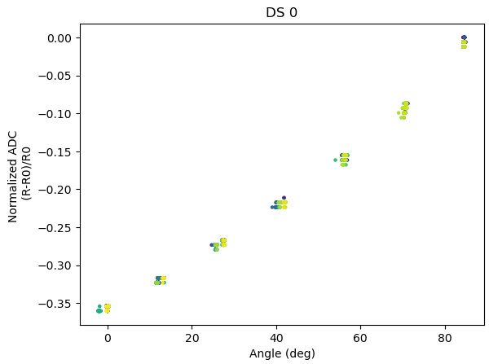
Typical Dataset: Scatter Plot Color Coded by Time

Slide 3
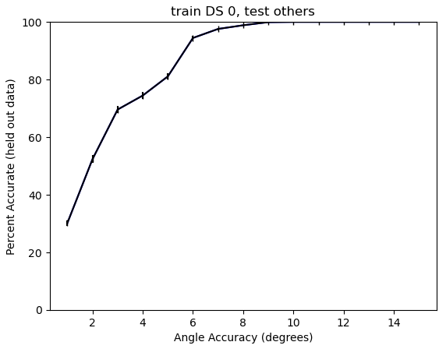
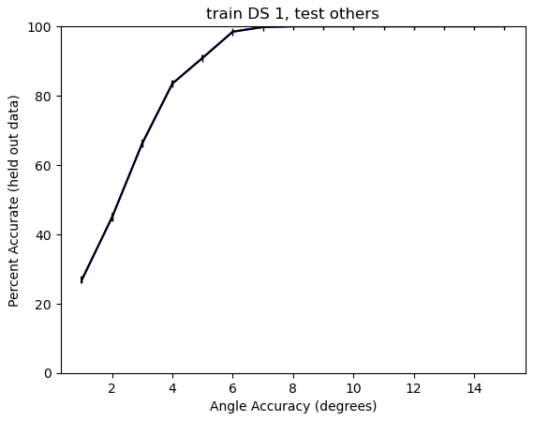
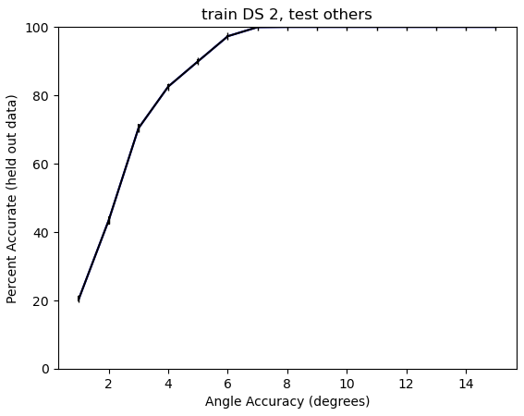
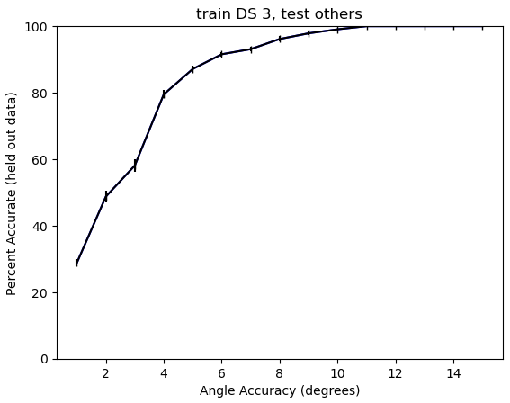
Reapplication 4 x

Slide 4
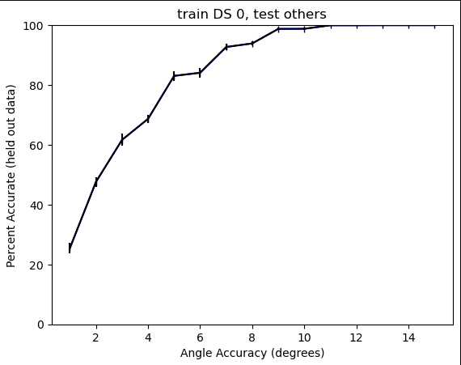
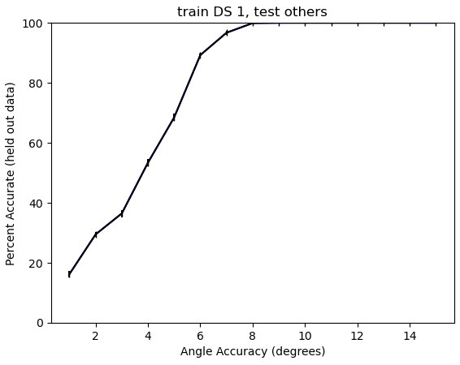
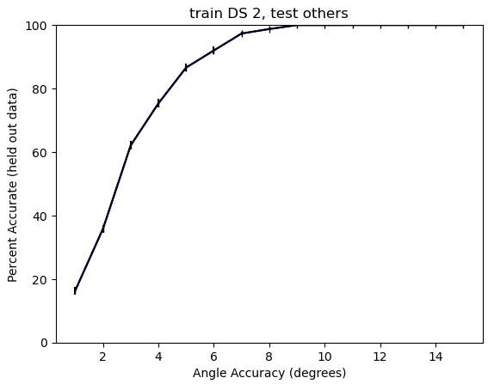
Misalignment: 0, 8, 20 deg

Slide 5
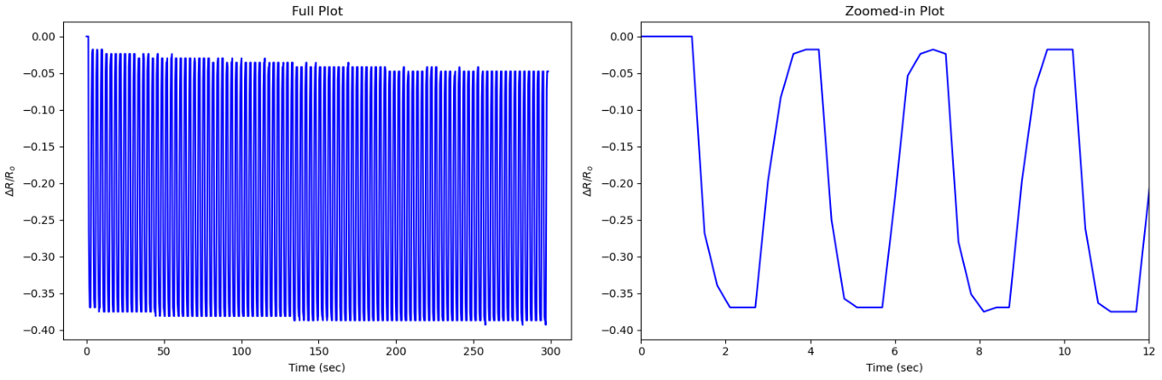
Dynamic Autobending: 0.3 sec period

Slide 6
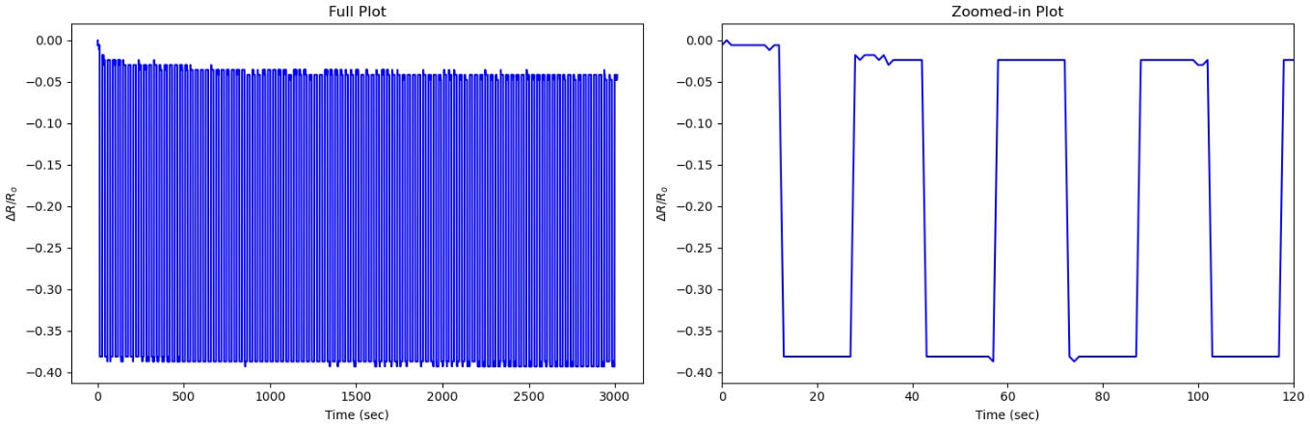
Dynamic Autobending: 1 sec period

Slide 7
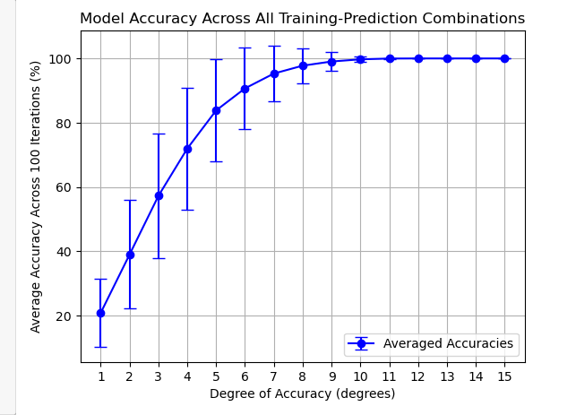
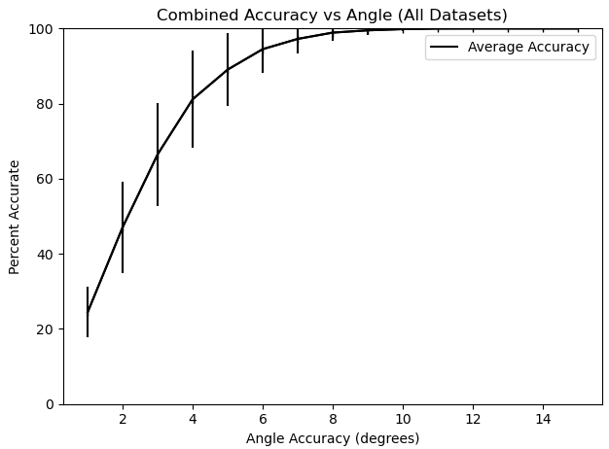
Across Sensor Repeatability: MinMax 12 files, where 1 is trained and is used to predict rest -> 132 prediction files in total

Slide 8
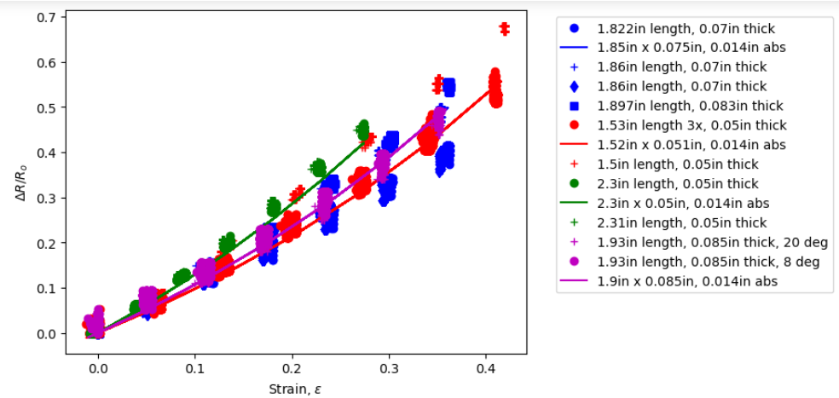
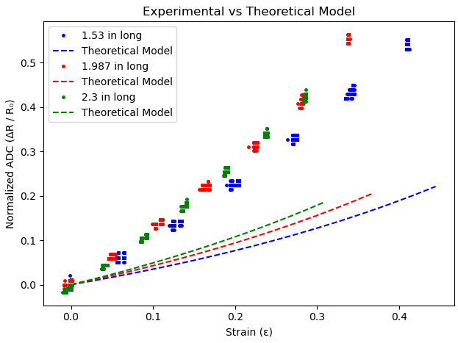
0.01” x 0.01”
0.02” x 0.02”

